Slide 1


Deep Fake Detection
Detection of “Deep Fake” Images using Deep Learning Techniques

Slide 2
Group Members
Avishkar Singh | IIT2020008
Pratham Gupta | IIT2020026
Shashwat Kumar Gautam | IIT2020030
Jay Suthar | IIT2020087
Akshat Ghariya | IIT2020505
Under the Supervision of Dr. Manish Kumar

Slide 3
Table of contents
01
02
03
04
05
06
07
Introduction
Literature Review
Introduction
Objectives
Deep Learning Techniques
Datasets
Results
References

Slide 4
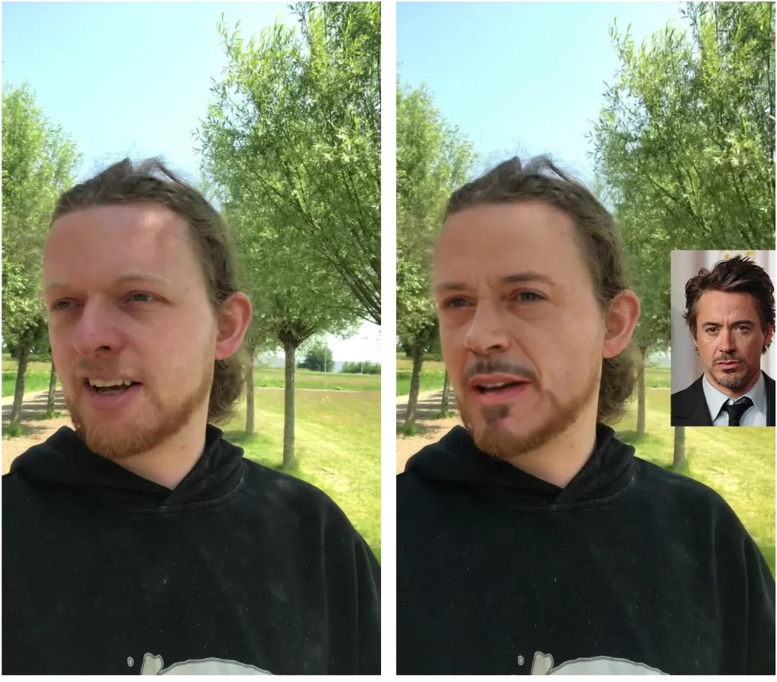
01
Introduction

Slide 5
What is Deep fake?
A deep fake is a portmanteau of "deep learning" and "fake."
It refers to synthetic media, particularly images and videos, that have been created or manipulated using deep learning techniques, specifically generative models.
Deep fakes are generated with the intent to deceive or mislead by making it appear as if something that didn't happen actually did, or vice versa.
They are often associated with the manipulation of human faces, voices, or bodies, leading to hyper-realistic impersonations.

Slide 6
Types of Deep Fake
Audio
Text
Video
Types of Deep Fake
Social Media
Images
Real Time

Slide 7
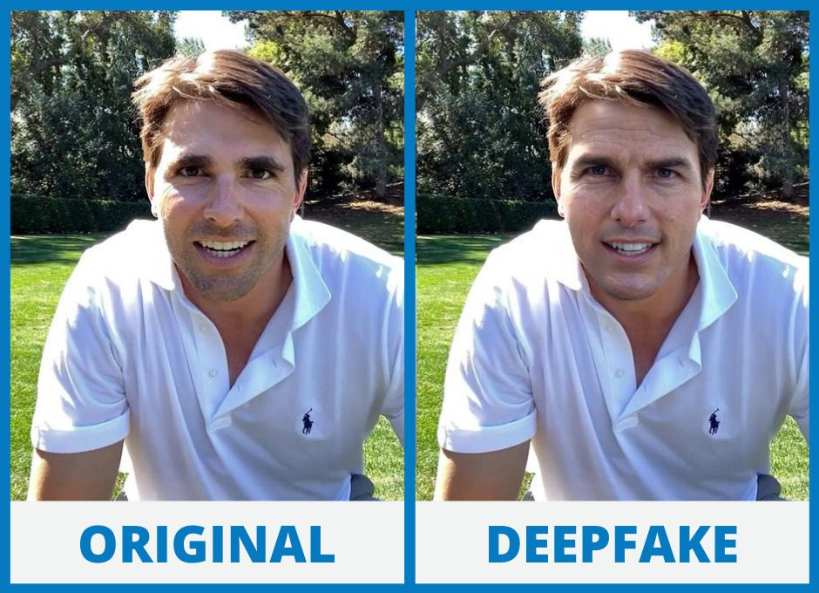
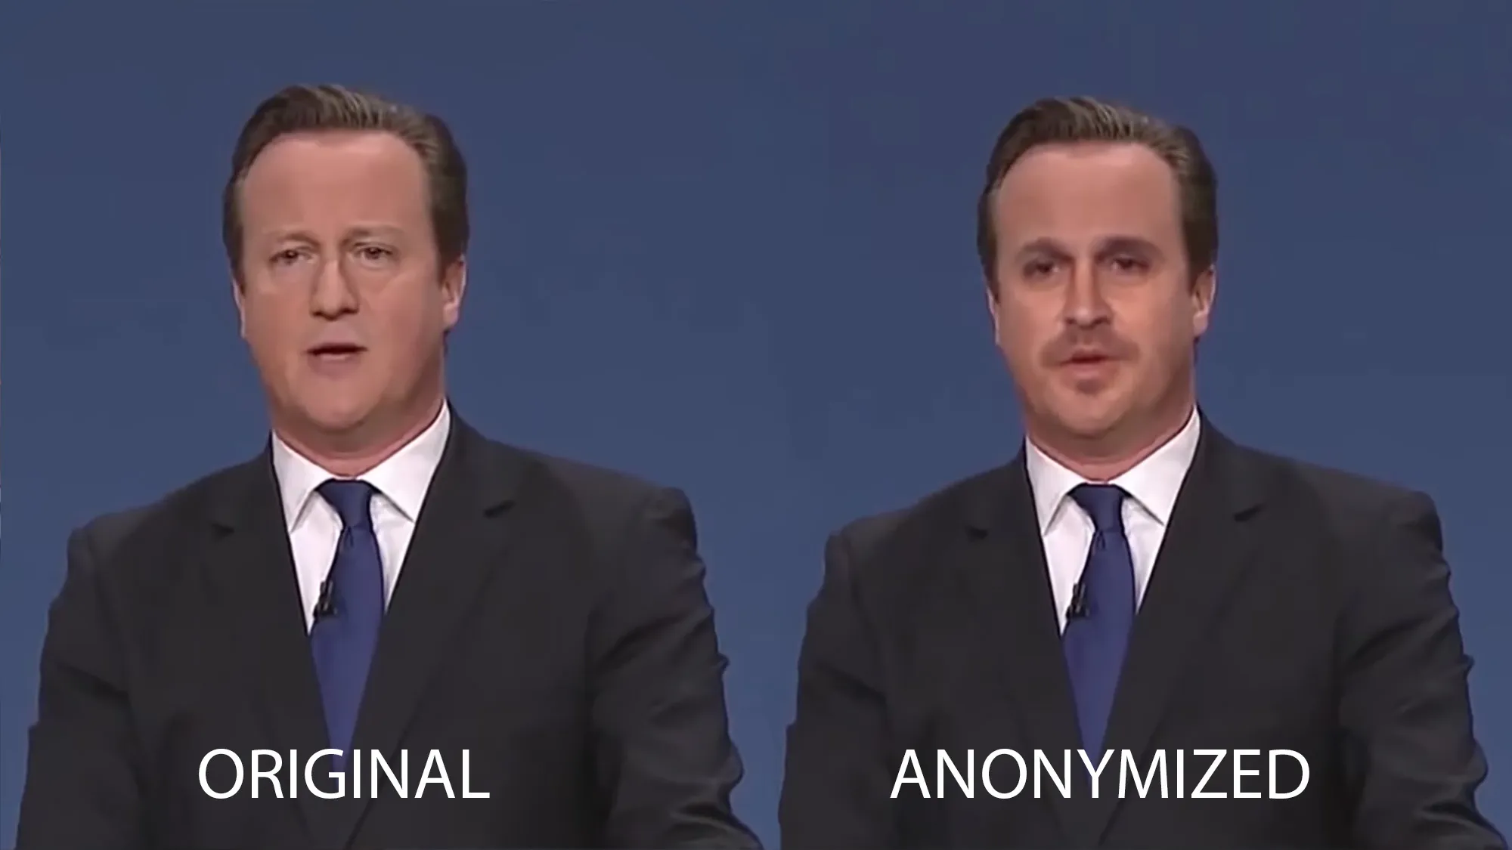
Examples of Deep Fake Images
Image Reference
Image Reference

Slide 8
Effect of Deep Fake
Misinformation and Disinformation
Defamation and Privacy Violations
Identity Theft and Fraud
Deep Fakes fuel confusion, spreading realistic yet false narratives in the digital space.
Deep Fakes escalate defamation, damaging reputations, and violating personal privacy boundaries
Deep Fakes amplify identity theft risks, enabling convincing impersonation and fraudulent activities.
Election Interference
Security Risks
Deep Fakes pose a threat to elections by manipulating public opinion with deceptive videos.
Deep Fakes heighten security risks, allowing malicious actors to exploit realistic forgeries in cyber attacks.

Slide 9

02
Objective

Slide 10
"Amidst the rise of 'Deep Fake' images and their potential for widespread deception, this project focuses on the fundamental task of detecting such manipulated visuals through the application of multiple deep learning techniques. The objective is to explore and evaluate various deep learning methods, gauging their efficacy in identifying 'Deep Fake' images across diverse datasets. By employing a range of DL approaches, this research seeks to advance our understanding of the capabilities and limitations of these techniques in the vital pursuit of countering deceptive visual content."

Slide 11
03
Literature Review
(Base Papers)

Slide 12
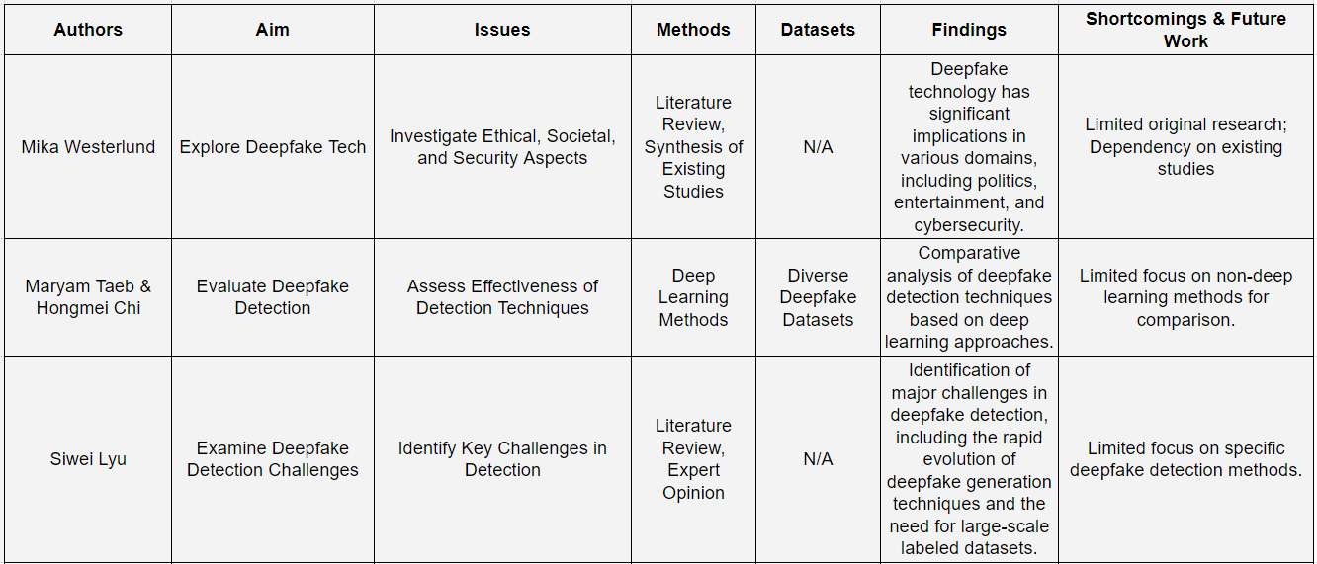

Slide 13
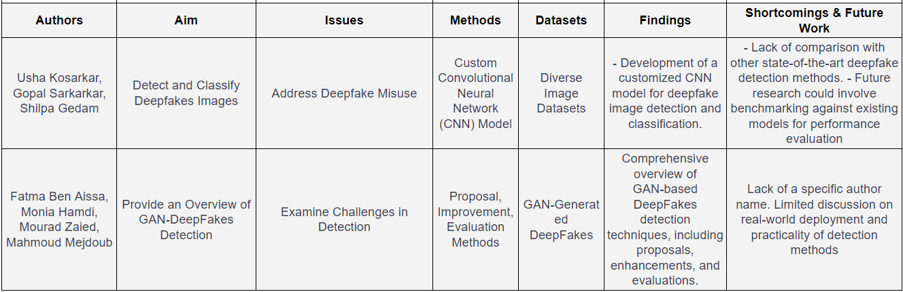

Slide 14
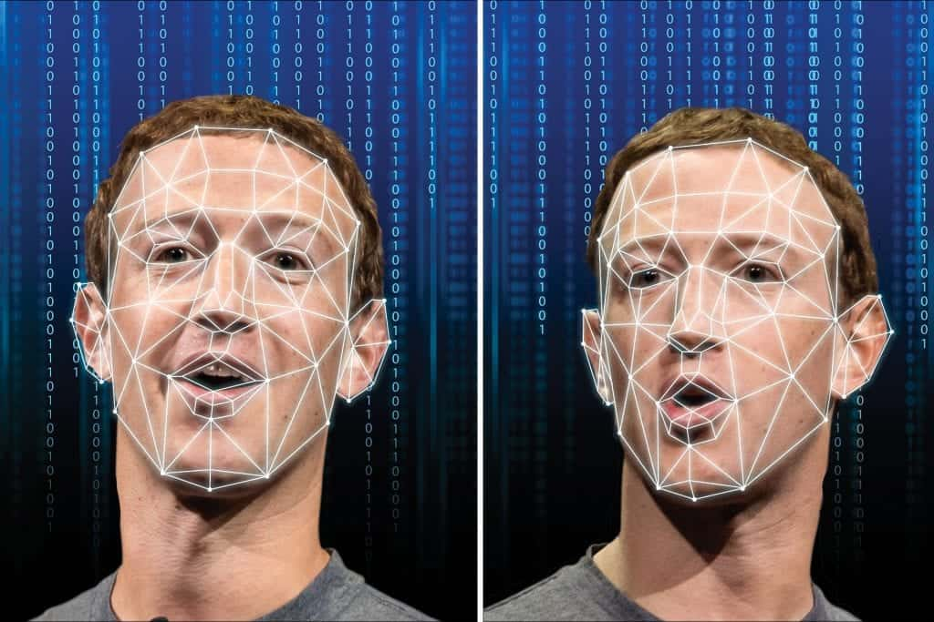
04
Deep Learning Techniques

Slide 15
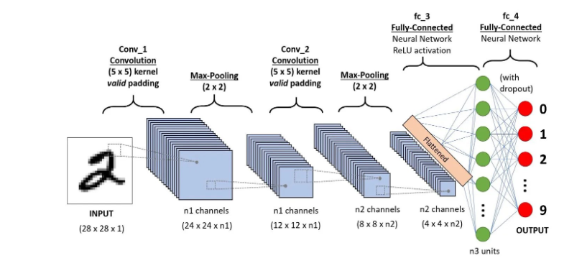
CNN
Ref:Cnn model

Slide 16
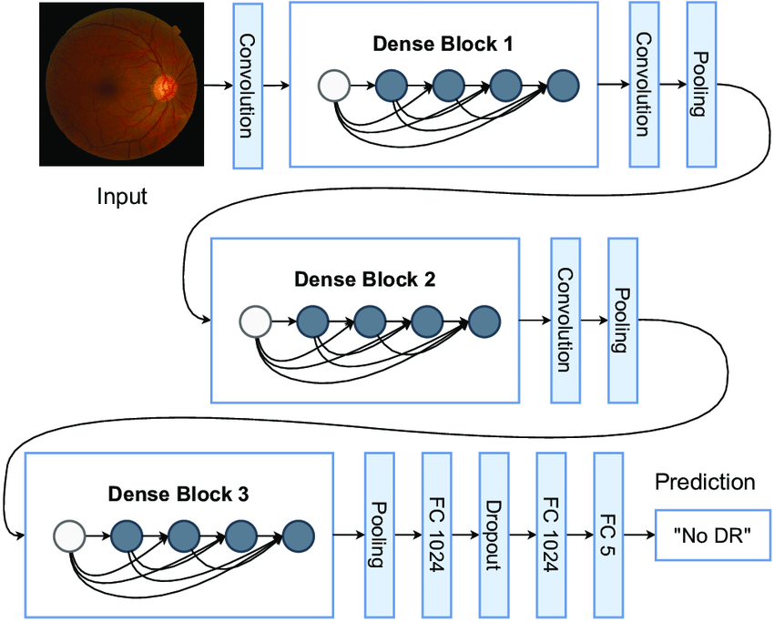
DenseNet121
Ref:dnt

Slide 17
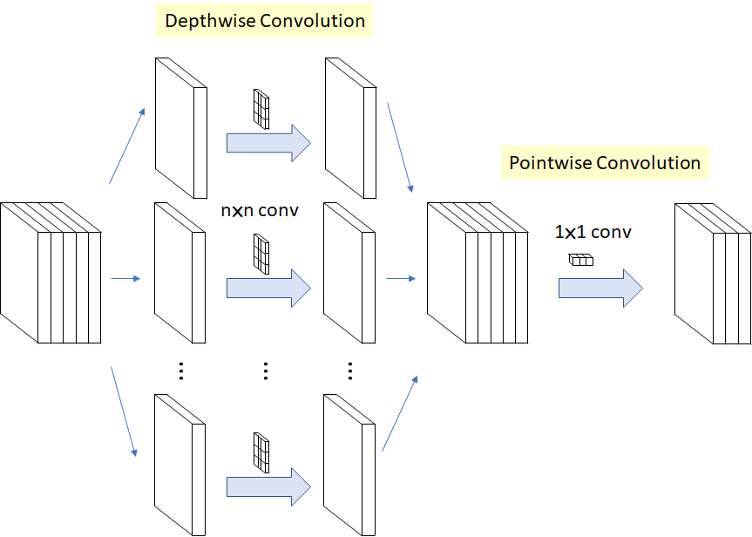
Xception
Ref:Xep

Slide 18
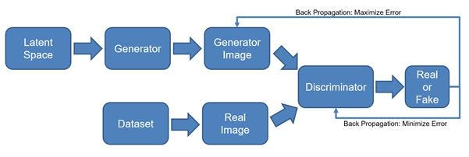
GAN (Generative Adversarial Networks)
Ref:Gan

Slide 19
05
Datasets

Slide 20
Dataset
IFakeFaceDB Dataset
190K-Faces Datasets
ForgeryNet Dataset
Flickr Image Dataset

Slide 21
iFakeFaceDB Dataset -
190K-Faces -
iFakeFaceDB is a face image dataset for the study of synthetic face manipulation detection, comprising about 20,000 synthetic face images ( generated by the StyleGAN model and transformed with the GANprintR approach) and real images. All images were aligned and resized to the size of 256 x 256.
This database contains 190,000 synthetic and real images. In this database the StyleGAN network was trained using around 29,000 photos of 69 different models, producing face images with a flat background.

Slide 22
ForgeryNet Dataset -
Flickr Image dataset-
ForgerNet dataset contains 2.9 million images and 221,247 videos, 7 image-level approaches and 8 video-level approaches manipulations from all over the world. Each video and image is associated with its label.
The Flickr dataset is a widely recognized dataset in the field of computer vision and natural language processing, specifically designed for tasks related to image description and language understanding. The dataset contains around 150,000 images(real and fake) collected from the photo-sharing platform Flickr, each accompanied by five descriptive sentences.

Slide 23

06
Results

Slide 24
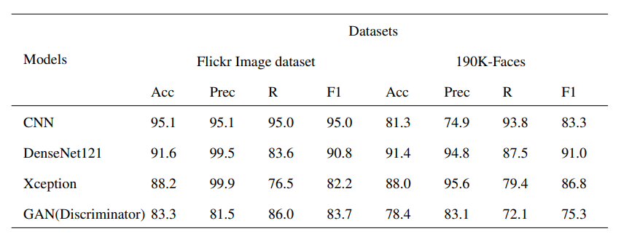
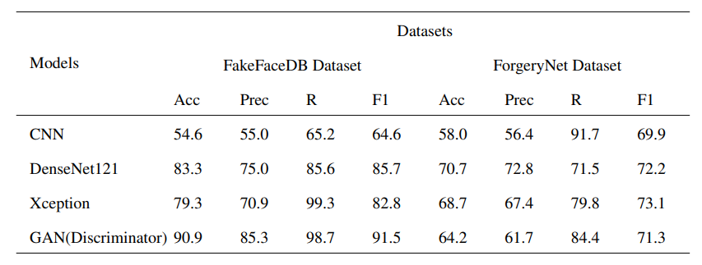

Slide 25
References
Ben Aissa, F., Hamdi, M., Zaied, M. and Mejdoub, M., 2023. An overview of GAN-DeepFakes detection: proposal, improvement, and evaluation. Multimedia Tools and Applications, pp.1-23.
Taeb, M. and Chi, H., 2022. Comparison of deepfake detection techniques through deep learning. Journal of Cybersecurity and Privacy, 2(1), pp.89-106.
Lyu, S., 2020, July. Deepfake detection: Current challenges and next steps. In 2020 IEEE international conference on multimedia & expo workshops (ICMEW) (pp. 1-6). IEEE.
Westerlund, M., 2019. The emergence of deepfake technology: A review. Technology innovation management review, 9(11).
Kosarkar, U., Sarkarkar, G. and Gedam, S., 2023. Revealing and Classification of Deepfakes Video's Images using a Customize Convolution Neural Network Model. Procedia Computer Science, 218, pp.2636-2652.
Kumar, M. and Sharma, H.K., 2023. A GAN-based model of deepfake detection in social media. Procedia Computer Science, 218, pp.2153-2162.

Slide 26
Patel, Y., Tanwar, S., Bhattacharya, P., Gupta, R., Alsuwian, T., Davidson, I.E. and Mazibuko, T.F., 2023. An Improved Dense CNN Architecture for Deepfake Image Detection. IEEE Access, 11, pp.22081-22095.
Parayil, A.M., Ameen Masood, V., Muhammed Ajas, P., Tharun, R. and Usha, K., DEEPFAKE DETECTION USING XCEPTION AND LSTM.
Raza, A., Munir, K. and Almutairi, M., 2022. A novel deep learning approach for deepfake image detection. Applied Sciences, 12(19), p.9820.
Seow, J.W., Lim, M.K., Phan, R.C. and Liu, J.K., 2022. A comprehensive overview of Deepfake: Generation, detection, datasets, and opportunities. Neurocomputing, 513, pp.351-371.
Taeb, M. and Chi, H., 2022. Comparison of deepfake detection techniques through deep learning. Journal of Cybersecurity and Privacy, 2(1), pp.89-106.
Wang, X., Guo, H., Hu, S., Chang, M.C. and Lyu, S., 2022. Gan-generated faces detection: A survey and new perspectives. arXiv preprint arXiv:2202.07145.

